Slide 1
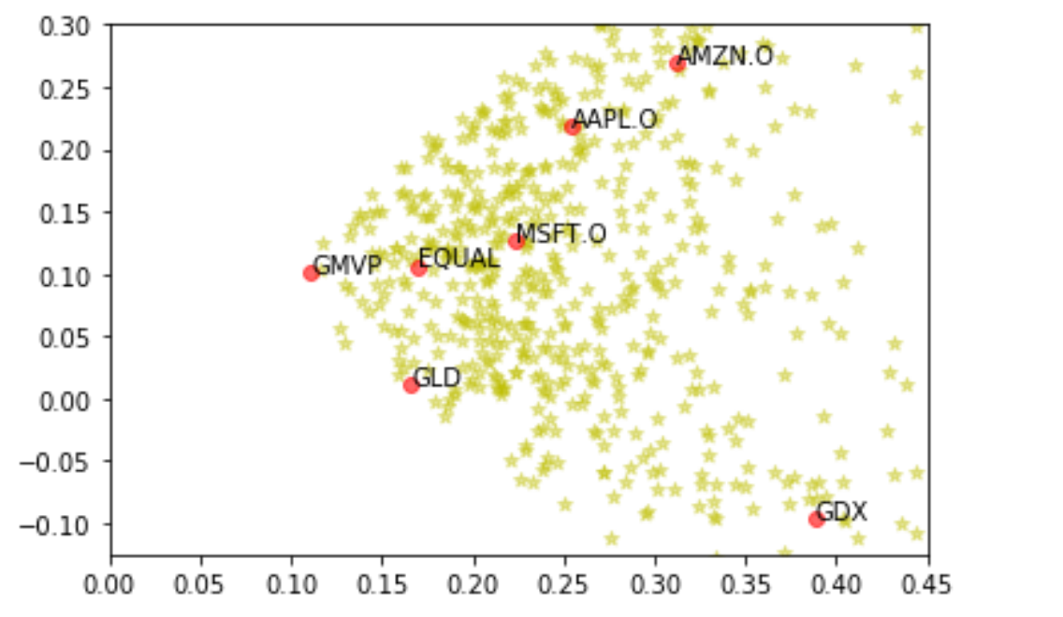
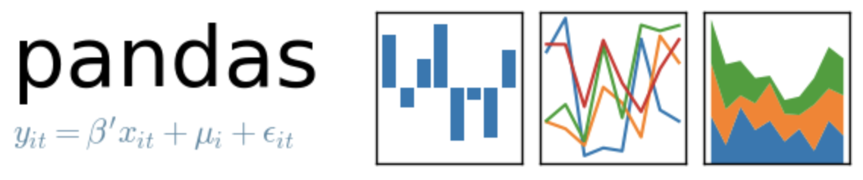
Portfolio Optimization
-
GMVP

Slide 2
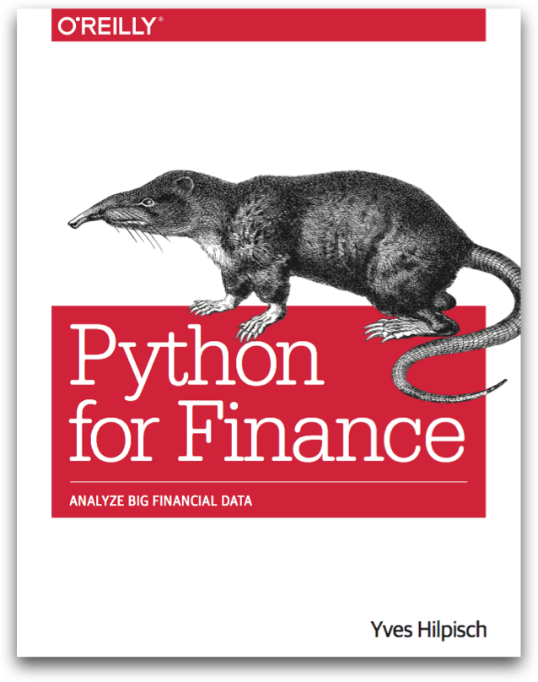
Reference
Chapter 11 of Python for Finance (O'Reilly)
Data
Youtube
Code

Slide 3
Data Loading

Slide 4
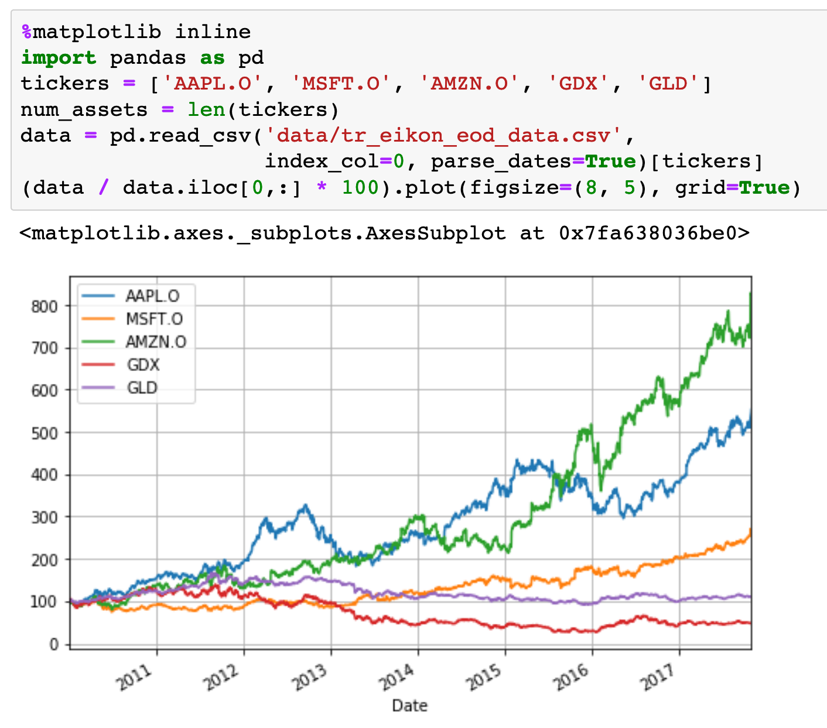

Slide 5
Computation
of
Mu and Sigma

Slide 6
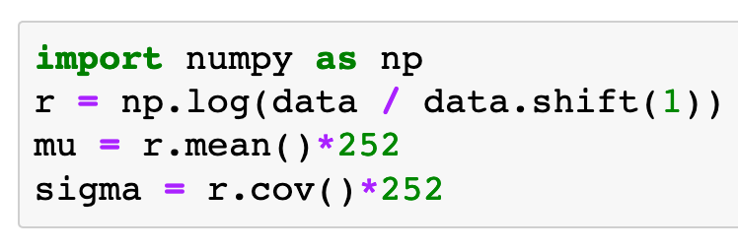
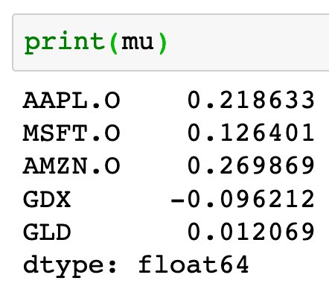
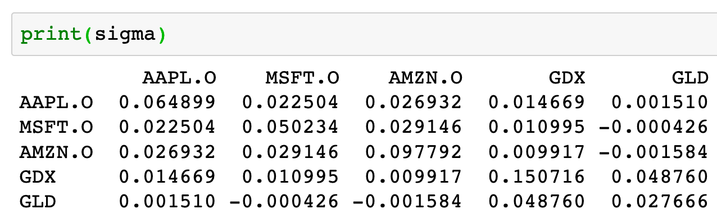

Slide 7
Risk-Return Plot

Slide 8
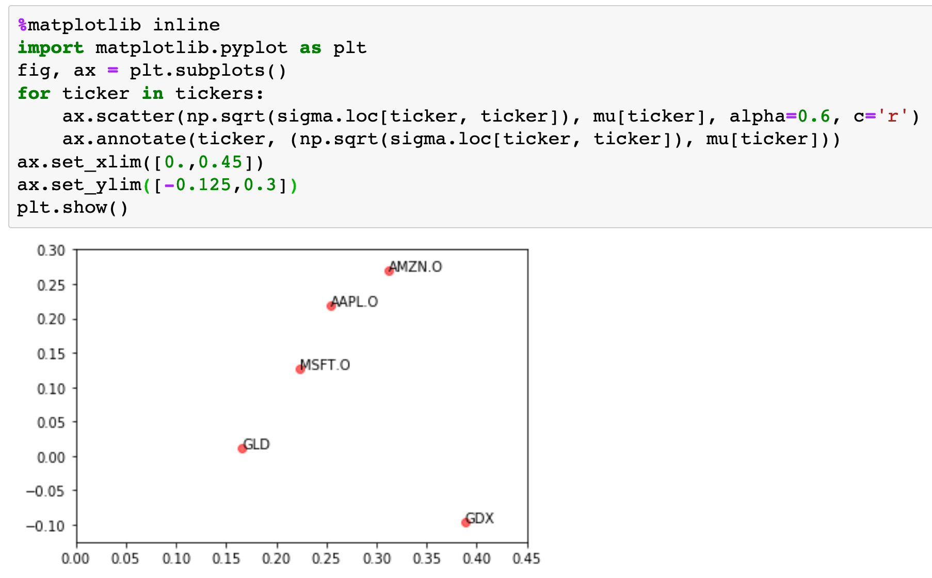

Slide 9
Copy
Original
Tickers, Mu and Sigma

Slide 10
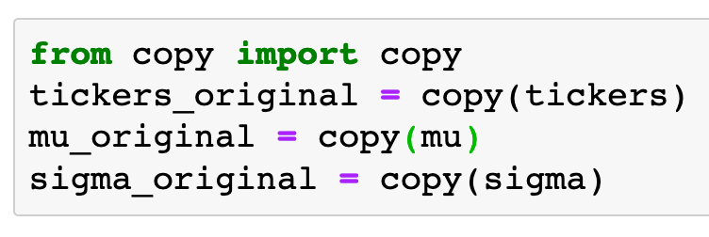

Slide 11
Computation
of
Portfolio’s Mu and Sigma

Slide 12
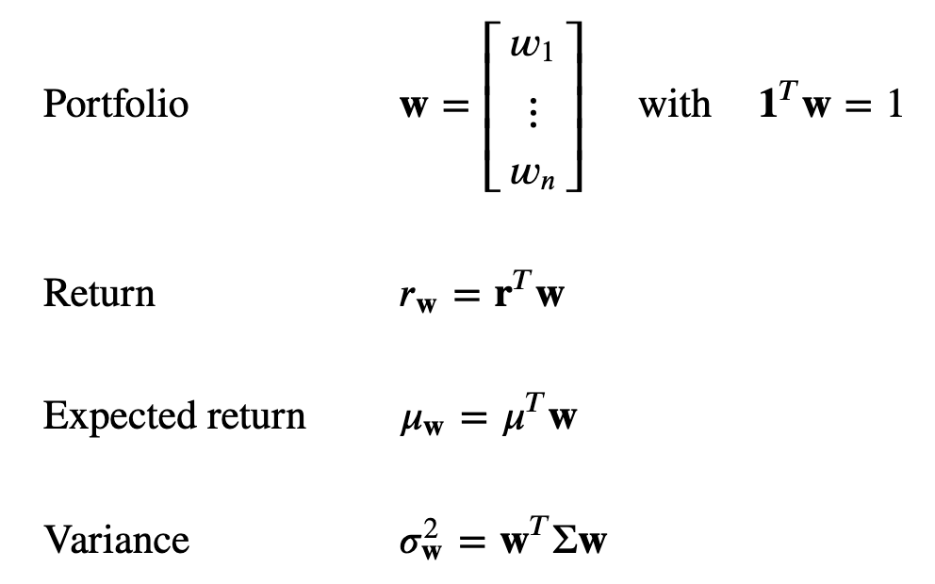

Slide 13
Random Portfolios
(No Short Positions)

Slide 14
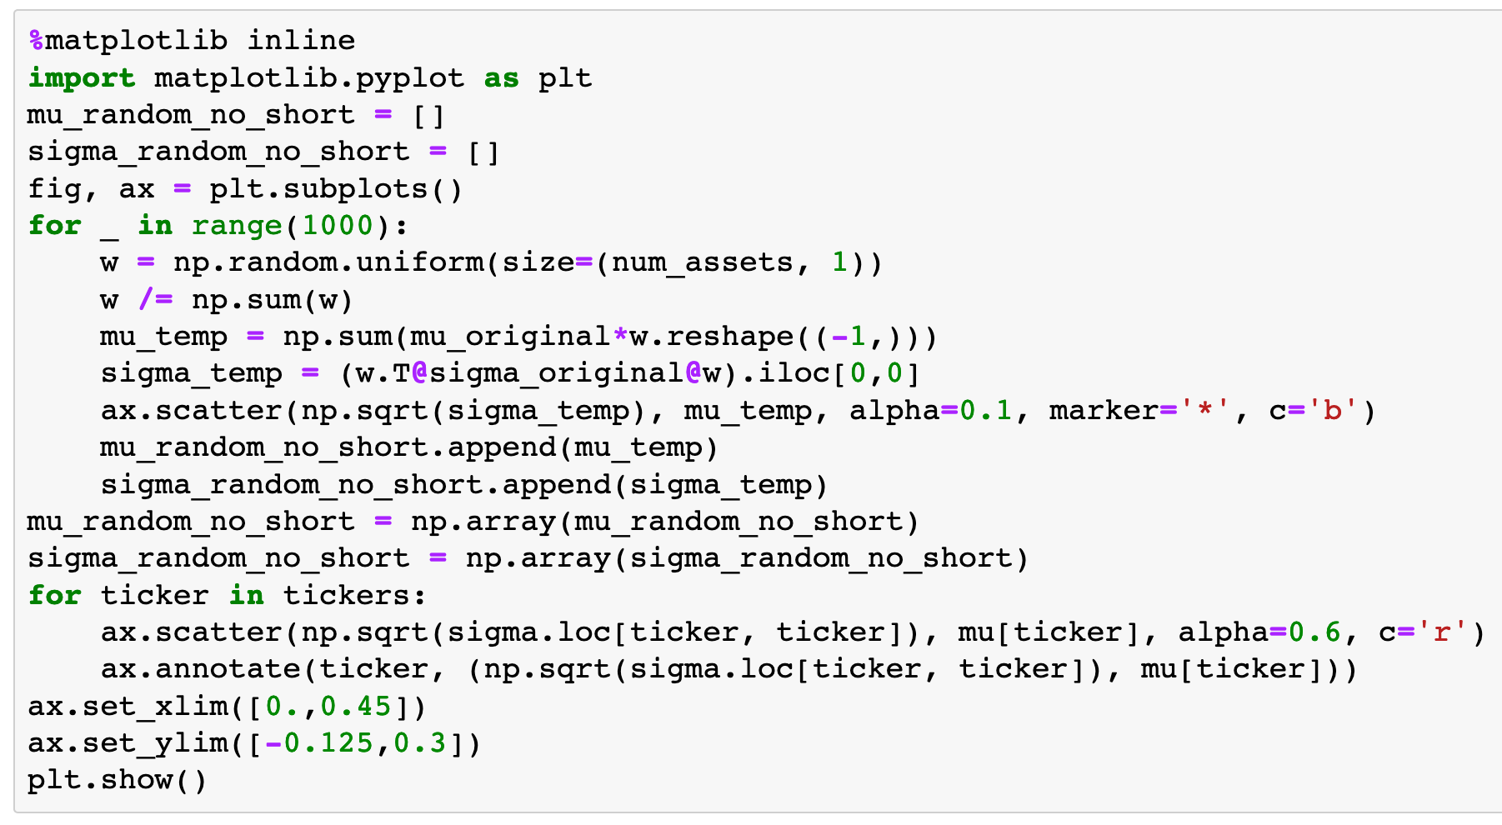

Slide 15
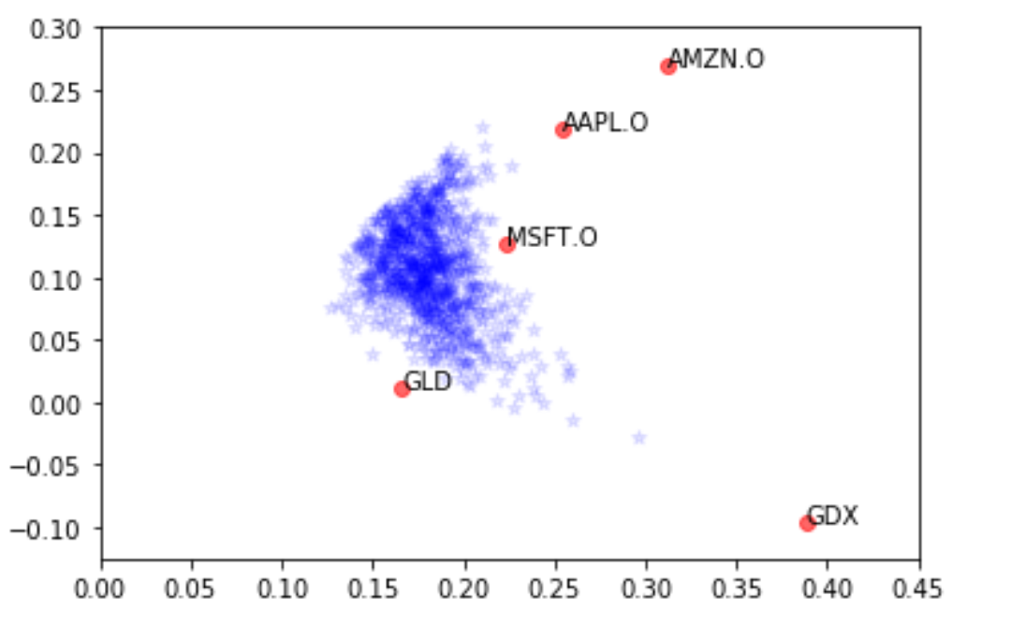

Slide 16
Random Portfolios
(Short Positions)

Slide 17
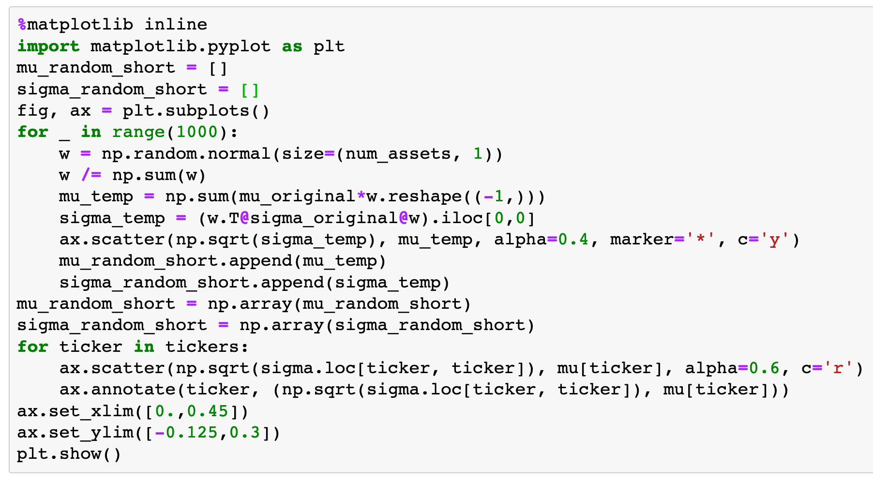

Slide 18
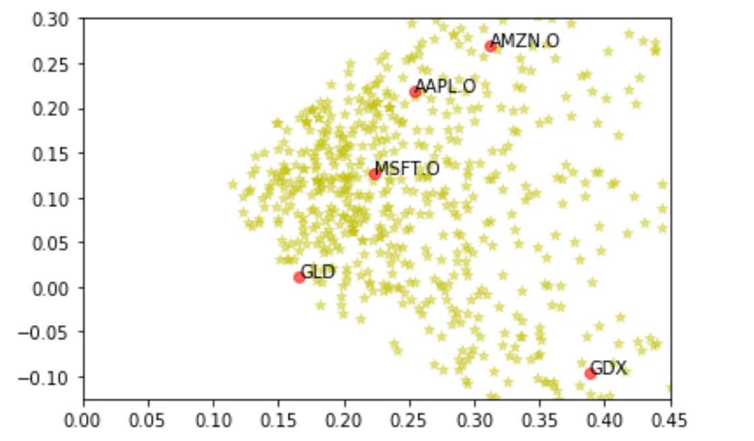

Slide 19
Equal Portfolio

Slide 20
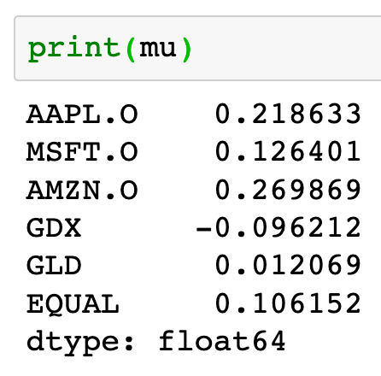
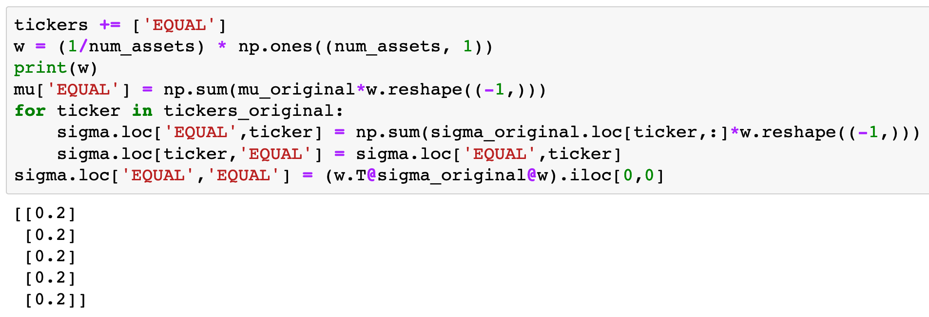
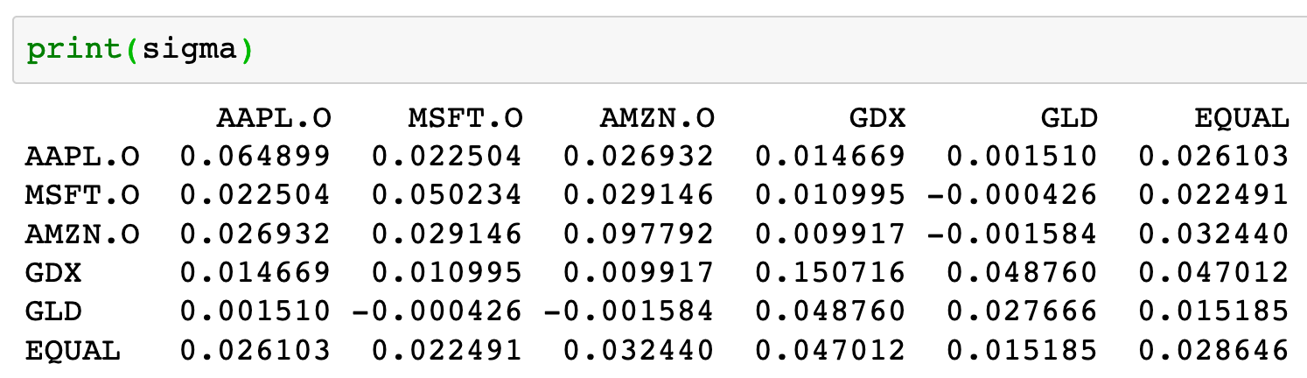

Slide 21
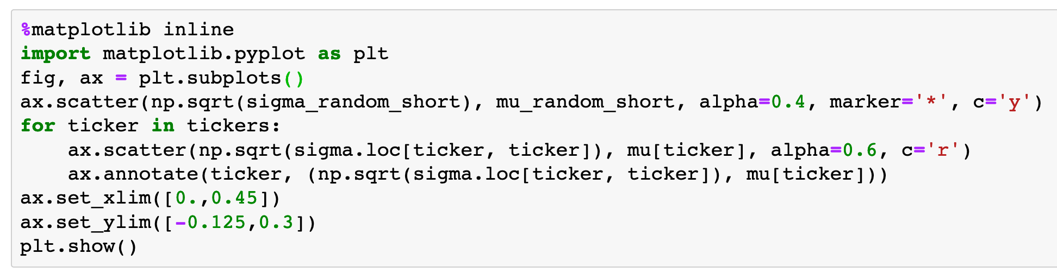

Slide 22
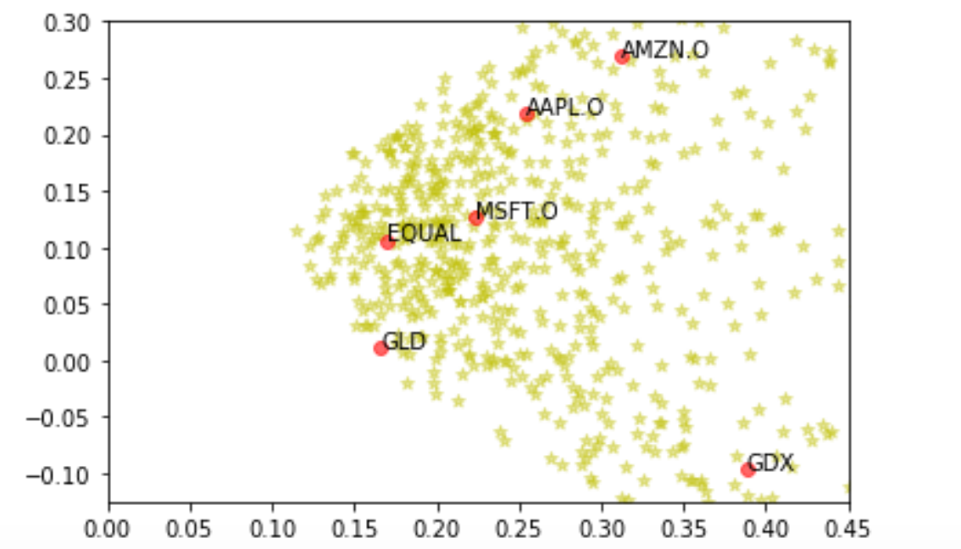

Slide 23
Simple Computation Formula of Gradient and Hessian

Slide 24
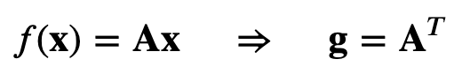
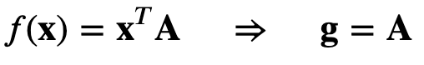
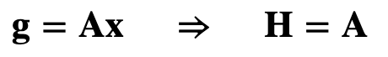

Slide 26
A
x
A.T

Slide 27
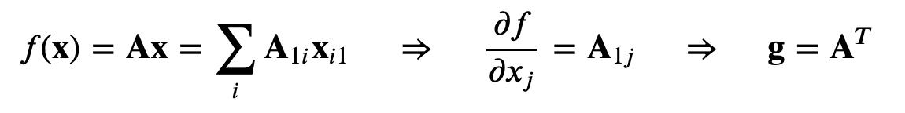
A
x
A.T

Slide 29
x.T
A
A

Slide 30
x.T
A
A

Slide 32
A
x
A

Slide 33
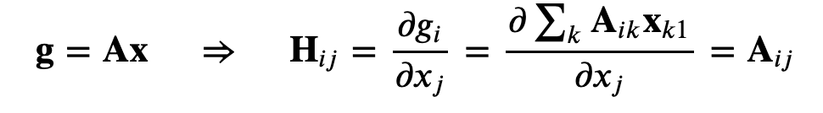
A
x
A

Slide 34
Global Minimum Variance Portfolio
(GMVP)

Slide 35
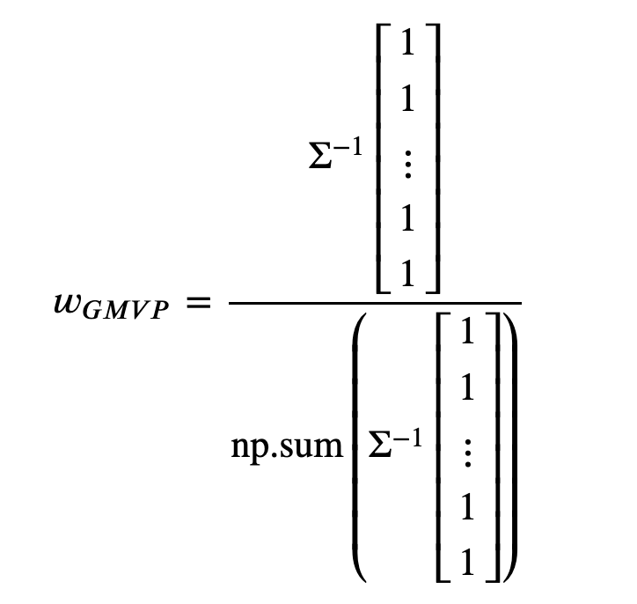

Slide 36
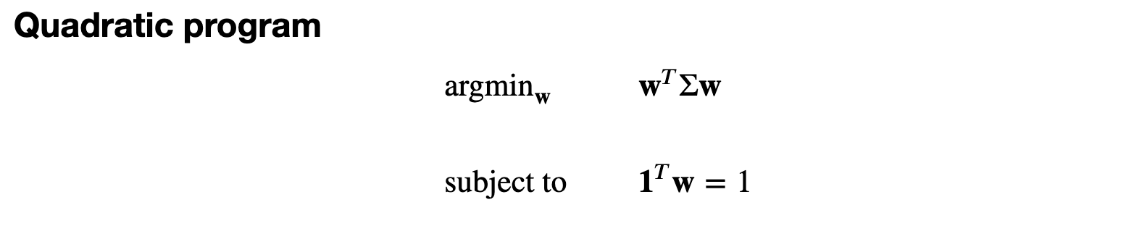

Slide 37


Slide 38
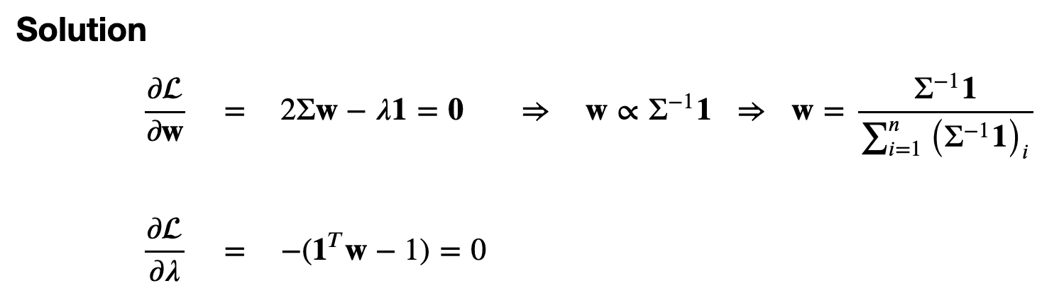

Slide 39
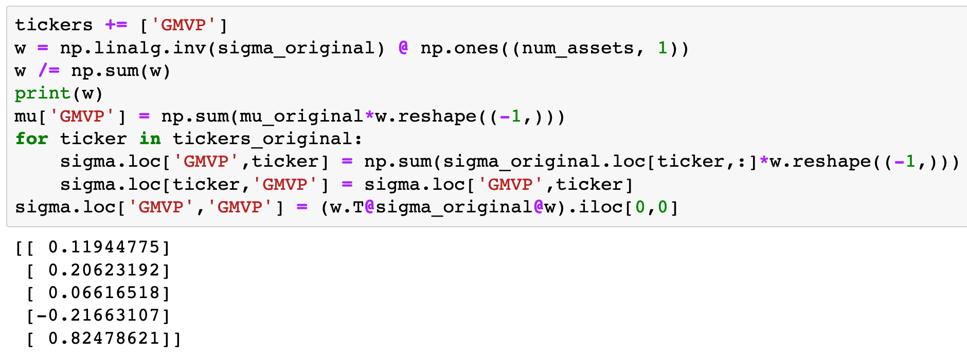

Slide 43
Normalize

Slide 45
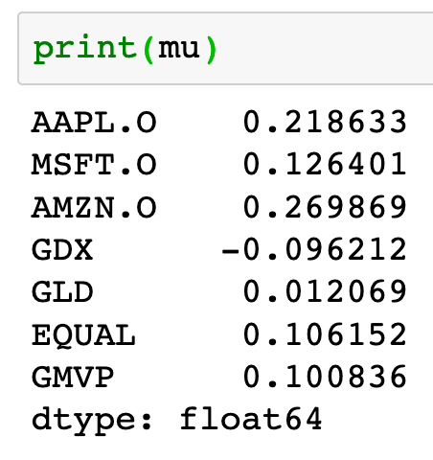

Slide 46
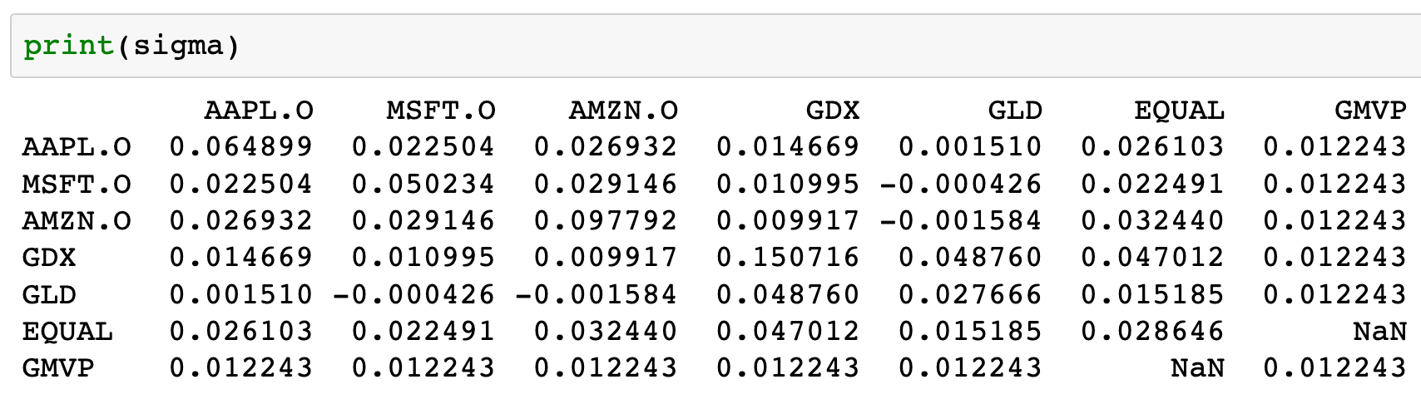

Slide 47
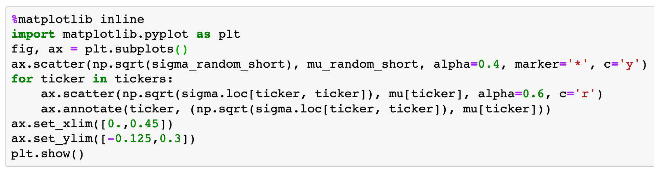

Slide 49
Copy GMVP

Slide 50
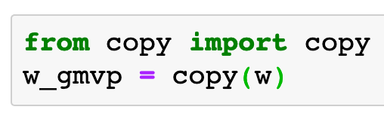

Slide 51
Now
Let’s Play with Code

